Slide 1
Software Development Capstone
Welcome!

Slide 2
Agenda
Course outline
Introductions
Syllabus
Python recap/warm up: Lab 1
Project 1

Slide 3
Software Needed
Python 3.8.latest, https://www.python.org/downloads/
Git – Macs have it already – https://git-scm.com/
An editor, e.g.
VSCode https://code.visualstudio.com/
Atom https://atom.io/
Notepad++ https://notepad-plus-plus.org/
Sublime Text https://www.sublimetext.com/
PyCharm (you won't use 99% of it's features though) https://www.jetbrains.com/pycharm/
Other editor of your choice
Other software will be needed, everything will be free for students

Slide 4
Course outline
Build projects
Do research, learn new things, solve problems, troubleshoot
Collaborate
Use software developer tools common in industry
Version control, issue tracking, build tools, package managers, testing, documentation…
Broaden and deepen your skills
Learn more about Python; learn more general knowledge
Employers want 'T-shaped developers' link
Class will use Python as a teaching language
Can accommodate if you'd really like to work on some projects in another language/platform – let's discuss

Slide 5
Course Pre-requisites
On paper: 2 x 6-credit programming languages
What you actually need to be successful in this class:
A solid level of programming skill
If those 6-credit classes were really tough for you; and/or you did not get a good grade; then you should consider taking more classes to build your programming skills before you attempt this class
An interest in learning more programming skills
Work ethic: attend, apply yourself, ask questions, get work done, show initiative

Slide 6
Introductions
Hi, I'm Clara. Used to be a Java engineer, been at MCTC about 7 years. Worked with Python, Android, various web technologies; interested in networks and security; been employed, freelance, self employed… a bit of a lot of different things. Python is one of my favorite languages and I really enjoy learning new technologies, and solving problems with code!
Please introduce yourself and tell us:
Which two 6-credit classes did you take?
What program have you written that you most enjoyed creating, or are most proud of?
What languages/platforms are you interested in working with in your career?
Anything you would really like to cover in this class?
No guarantees but I will make a note of it :)
(Optional) something you are looking forward to in 2020

Slide 7
Syllabus
In D2L, content section
Please read the whole thing carefully, and please ask if you have any questions

Slide 8
Typical class
Introduction, objectives/motivation for the class topic, sample programs
Lab – may be individual and/or collaboration with other students
You must check out with me before you leave
You should definitely ask questions
I like questions! If I don't know the answer, it's interesting to find it out - always good to learn more!
Feedback on your labs as you work on them is much more valuable than feedback after they are turned in
Labs are due AT THE END OF CLASS!
All of the labs are 15% of your grade in total - project are worth much more, you should spend most of your time on projects

Slide 9
Lots of topics
We couldn't fit everything in… And we can't cover everything in depth
Theory: better to know about the existance of a particular tool and used it once; than be unaware of common tools/technologies
No-one told me about version control at college!
Doing more research on some/all of the topics is encouraged
Investigate how these tools are used in other languages (e.g. how does package managment work in C# ? How does logging work in Java? )
Some topics may be set as extra credit

Slide 10
Remember…
This course will be what you make of it
Are you in it for the grades?
Or for the skills you need for your desired career?
Employers don't care much about your GPA. They care about what you can do, and your enthusiasm and ability to learn more
Focus on learning, understanding, and expanding and improving your skills. Create outstanding projects for your GitHub portfolio.
And then points will follow

Slide 11
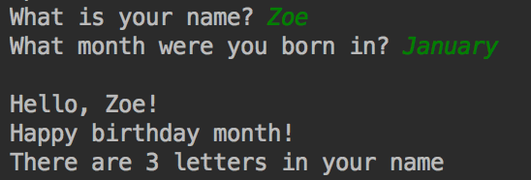
Python warmup
Write a program that asks for your name and the month you were born in
Your program should print
A greeting to you, using your name
A message with the number of letters in your name
A 'Happy birthday month!' message if you were born in January
Example output ->

Slide 12
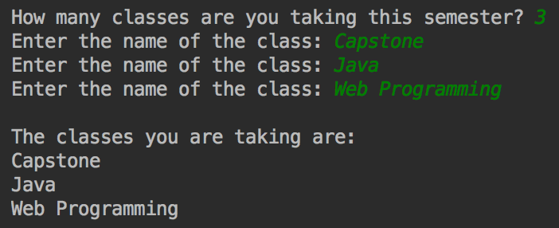
Python warmup 2
Write a program that asks for the names of all of the classes you are taking this semester
Save these class names in a list
Print all the items in the list, one per line
Example output ->

Slide 13
Some Useful Python Things
You may not have used a lot of language features in Programming Logic
We'll see many Python features in the class, but we'll start with a couple that I use a lot
Python has many features that reduce the amount of code you need to write, especially compared to languages like C# or Java

Slide 14
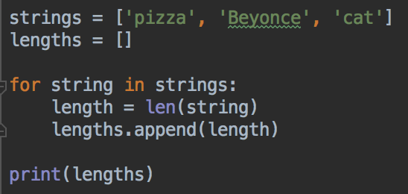
List Comprehensions
Example: you have a list of strings
You want a list of the lengths of these strings
So, ['pizza', 'Beyonce', 'cat'] -> [5, 7, 3]
You can do it with a loop

Slide 15
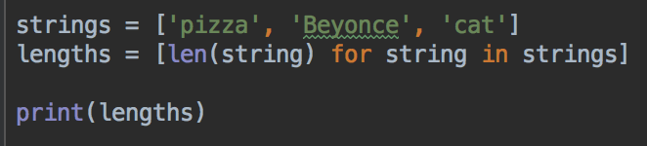
List comprehension syntax
If you are making a list from another list, you can use list comprehensions
How to convert string to item in new list
Loop over list

Slide 16
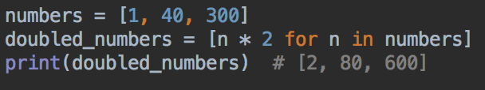
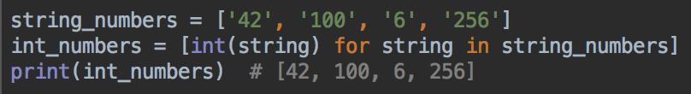
More examples
Make a list of numbers, each number should be double the original value
Convert strings '42' '100' to their int equivalent

Slide 17
Your turn
Start with the list [2, 4, 6]
Write a list comprehension to make a new list with each number increased by one
So, your program should create the list [3, 5, 7]

Slide 18
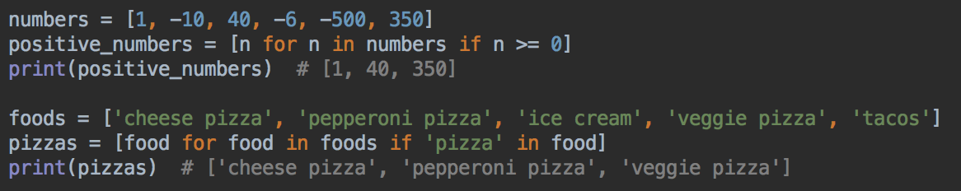
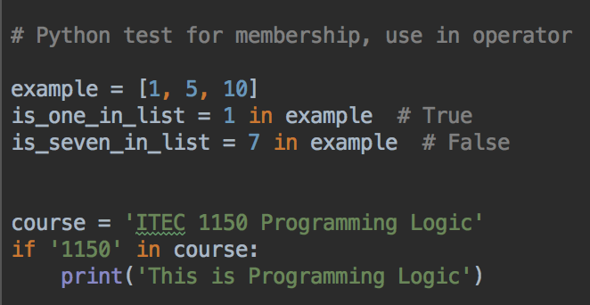
Make a list from only certain values of the original list
Can add a condition to filter the list
Remember that Python doesn't have contains() methods, use the in operator to see if a string contains a substring, or a list contains a item

Slide 19
Your Turn
Start with the list [0, 3, 4, 0, 22, 1]
Create a new list with all the non-zero numbers
So your program will create the list [3, 4, 22, 1]
Start with the list
['ITEC 2560', 'BTEC 1010', 'ITEC 2905']
Make a new list, filter out the non-ITEC classes

Slide 20
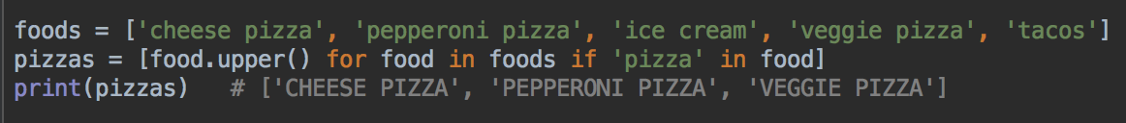
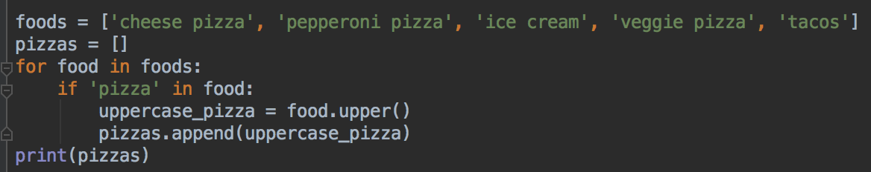
Can combine filtering and operations
Uppercase all food items, but only if it's pizza
Equivalent, with loop and if statement

Slide 21
Your turn
Start with the list [0, 10, 4, 0, 32]
Make a new list with all the numbers doubled, but only if the number if not zero
So the new list will be [20, 8, 64]

Slide 22
List comprehensions
If you prefer, you can always use loops and if statements in place of list comprehensions
Whatever you understand better, is usually the right choice
Readability is better than conciseness
But, it's also nice to save typing, and you'll see list comprehensions a lot in Python code

Slide 23
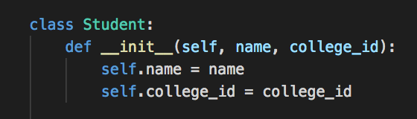
Classes in Python
Even though we didn't cover classes in Programming Logic, Python is an object-oriented language
Example class to represent a student
__init__ is an initializer method, used in similar ways to a Java/C# constructor

Slide 24
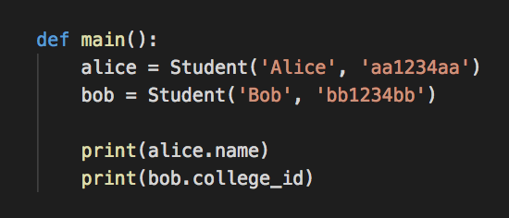

Creating Student objects
No need for getters and setters - attributes are public by default, can access directly

Slide 25
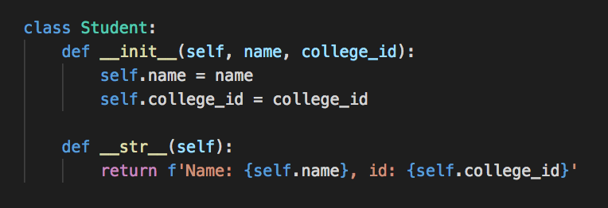
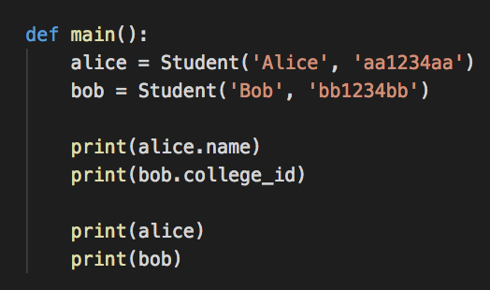

Methods for Student class
__str__ is like Java's toString, C# ToString

Slide 26
self
First argument to all class methods is self
self is like this in Java/C# - it refers to this object, this instance of the class
Within a class, all class properties are referred to as self.property

Slide 27
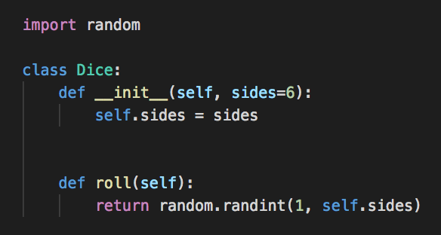
Another Class in Python
Python methods/function parameters can have default values
Most dice have 6 sides, so can make that a default value

Slide 28
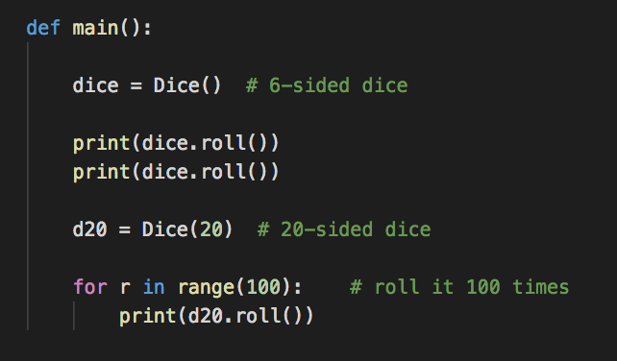
Using the Dice class
Note use of default argument when creating Dice objects

Slide 29
Your turn
Modify the Student class to have one more attribute: gpa, to store a student's GPA
Modify the __init__ and __str__ methods
Create some example student objects
Can you print a Student's GPA?
Can you change a Student's GPA?

Slide 30
Your turn
Create a new class called Author
An Author has a name, and a list of books published
When you create a new Author, they don't have any books. So create an empty books list attribute in __init__
Your Author class should have a publish method, which takes the title of a book as an argument. Add the title of this book to this object's books list
Add a __str__ method that returns a String with the author's name, and the names of all of their book's titles
Write a main function to test your class, create some example authors, and publish some example books

Slide 31
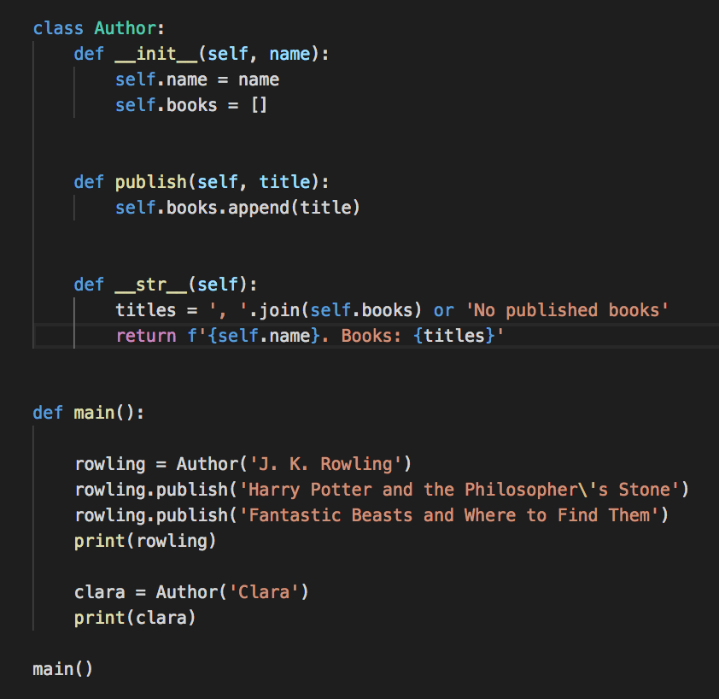
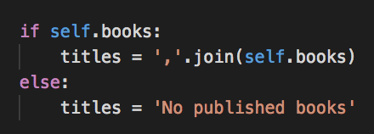
Example solution
data = a or b
if a is truthy, data will be set to a
If a is falsy, then var will be set to b
In Python, empty lists, empty strings, None, 0 and False are falsy
Does the same as this

Slide 32
dataclasses
Some classes have a lot of logic in them
Other classes are mainly used to store data
#Student class for storing name and college ID
class Student:
def __init__(self, name, college_id):
self.name = name
self.college_id = college_id

Slide 33
dataclasses
Introduced in Python 3.7
More info, ways to customize and use:
https://docs.python.org/3/library/dataclasses.html

Slide 34
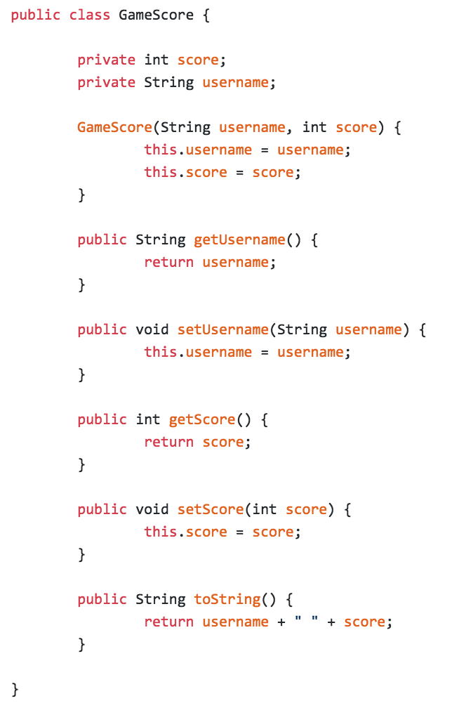
dataclass
Python's dataclass remove a lot of the boilerplate* from class definitions
Give you __init__, __str__ methods for free
*Standard code that is included in many places and is usually very boring to write, e.g. constructors that simply set values, get and set methods, toString/__str__ methods....
Java class with lots of boilerplate

Slide 35
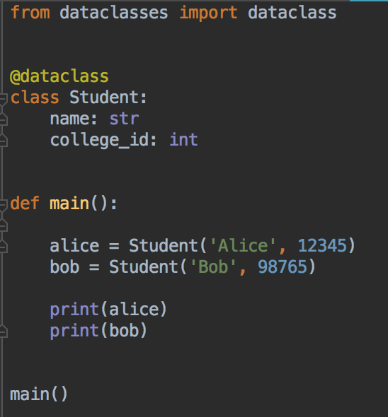

python dataclass
Can re-write the Student class like this
Use the @dataclass decorator
List the variables and their types
__init__ and __str__ method are generated automatically
Can override generated methods if you need custom features

Slide 36
Your Turn
Type in the dataclass code from the previous slide
Add one more field: gpa, a float
Write a main function to create some example Student objects
Compare the dataclass version to the "traditional" version

Slide 37
Lab 1
Hello Python
Some Python programs, practice basics
Please ask if you have any questions
Turn your lab work in before you leave
You will get partial credit if it is not finished
Completed? A grade. Good effort? B grade.

Slide 38
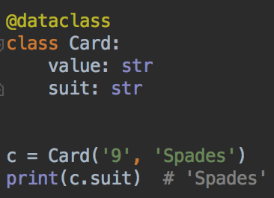
Project 1
Simple game
Due before next class so don't make it too complex
Objectives: more Python practice, make sure you are familiar with syntax and basic language features
For all projects: code quality is more important than quantity

